Slide 1

Computer Engineering Department A.P. Shah Institute of Technology G.B.Road,Kasarvadavli, Thane(W), Mumbai-400615 UNIVERSITY OF MUMBAI Academic Year 2019-2020

Slide 2
Master TimeTable Generator
Submitted in partial fulfillment of the degree of Bachelor of Engineering(Sem-7) in Computer Engineering By Suraj Thakkar 16102057 Neel Dhruva 17202003 Adesh Thosani 17202001 Under the Guidance of Dr. Rahul Ambekar

Slide 3
1.Project Conception and Initiation

Slide 4
1.1 Abstract
Many colleges use manual process of preparing academic timetables with large number of constraints and this is very time consuming.
This usually ends up with various courses clashing, this may be either at same room or with same teachers having more than one course at a time.
These are just due to common human errors which are very difficult to prevent and also a very hectic and cumbersome activity.
To overcome all these problems we propose this application of Master Time Table Generator.
There are many departments in a college/institute and each department has its own time table with sharing some common resources like rooms, infrastructure and faculty also , the master time table will generate the copy of time table integrating all time tables of various departments considering the needs of the said departments.
It will be implemented with the information required such as Faculty Name, Faculty Load,Preference of the Time slot, Required hours for the faculty.
The proposed application is intended to be used in any institutes irrespective of their discipline and number of departments.

Slide 5
1.2 Objectives
The main objectives of our project will be:-
The final system should be able to generate time table in completely automated way which will save lot of time and effort of an institute.
User defined constraints handling.
Ease of use of user of system so that he/she can make automated time table.
Focus on optimization of resources.
Generate multiple useful views from the timetable.
Managing all the information about semester course, faculty, and classrooms.
Building the application to reduce the manual handwork load.

Slide 6
1.3 Literature Review
Evolutionary techniques have been used to solve the time table scheduling problem.
Methodologies like Genetic Algorithms (GAs), Evolutionary Algorithms (EAs) etc have been used with mixed success.
In this , we have reviewed the problem of educational time table scheduling and solving it with genetic algorithm.
been used to solve the time table scheduling pro

Slide 7
1.4 Problem Definition
For all educational institutions, the timetables are prepared manually.
The class time-table module mainly focuses on year,semester,branch and section.By selecting the above fields, it will display the appropriate Department time-tables.
The class time-table module mainly focuses on year,semester,branch and section.
By selecting the above fields, it will display the appropriate Department time-tables.

Slide 8
1.5 Scope
Timetable Generation System generates timetable for Faculties, in keeping with the availability calendar of Faculty, availability and capacity of physical resources such as classrooms and rules applicable at different classes, semesters, faculties and subjects.
Best of all, this Timetable Generation System tremendously improves resource utilization and optimization.

Slide 9
1.6 Technology stack
Various algorithms will be used for implementing this applications.
Genetic Algorithms
Different languages will be used.
C,JAVA,HTML,CSS,PHP.
Different databases will be created for this :
MySQL
MongoDB

Slide 10
Genetic Algorithms:- It is a method for both constraints and unconstraints optimization problem that is based on natural selection, the process that drives biological evolution. 1.The evolution usually starts from a population. 2.Selection of chromosome according to fitness 3.Crossover between selected chromosomes 4.Perform mutation 5.Check for condition Terminlogies of GA 1.Gene 2.Chromosome 3.Population 4.Reproduction 5.Crossover 6.Mutation
Algorithms

Slide 11
1.7 Benefits for environment & Society
It is complicated task that to handle many Faculty's and allocating subjects for them at a time physically.
So our proposed system will help to overcome this disadvantage.Thus we can produce timetable for any number of courses and multiple semesters.
Separate timetable for the individual class, faculty and labs are generated automatically by this system.
The project reduces time consumption and the pain in framing the timetable manually.
The project is developed in such a way that, no slot clashes occur providing features to tailor the timetable as of wish.
It will save time and efforts.It will help to reduce errors.After Sucessful Completion of the project, The Master TimeTable can be used in many different Institutes.

Slide 12
2. Project Design

Slide 13
2.1 Proposed System
The proposed system is designed to be more efficient than the actual manual system.
Most colleges have a number of different courses and each course has ‘n’ number of subjects. Now there are limited faculties, and each faculty might be teaching more than one subjects.
So now the time table needed to schedule all the faculty at provided time slots in such a way that their timings do not overlap and the time table schedule will make the best use of all faculty subject demands.

Slide 14
2.2 Description Of Class diagram
The diagram represents Class Diagram for Time Table Generator system.
Here student , faculty, timetable generator were depend on administrator because the administrator can able to modify the details of the students, Faculty and timetable.
So dependency relationship is exist between students and administrator, Faculty and administrator.
This dependency is also exist between the timetable generator and timetable viewer. since because we can view timetable only after it is generated.

Slide 15
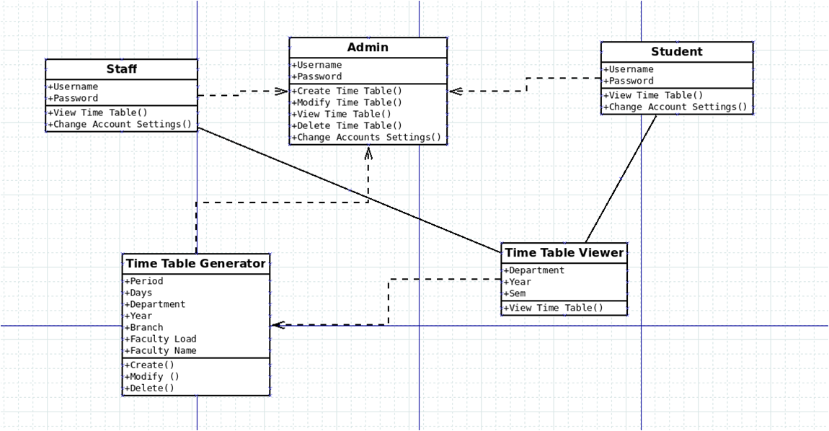
2.3 Class Diagram

Slide 16
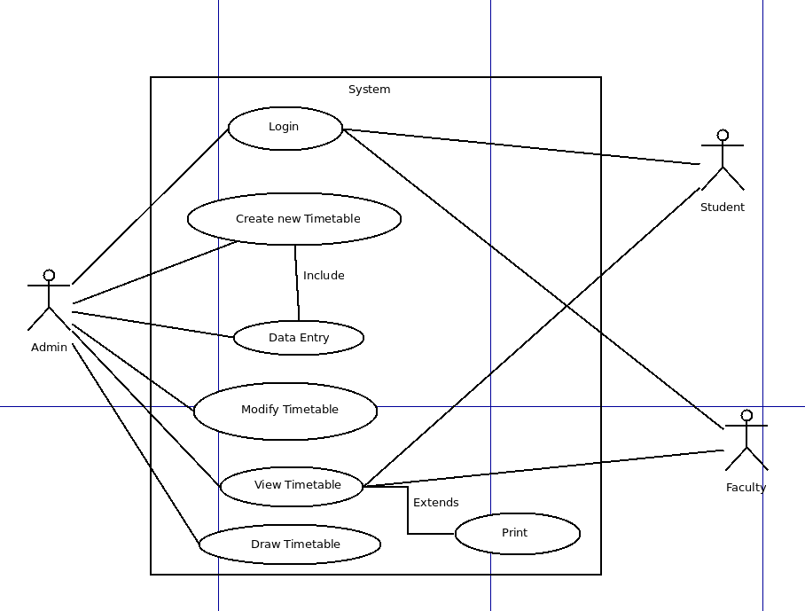
2.4 USE CASE DIAGRAM

Slide 17
2.5 Design(Flow Of Modules)
Department level module
Faculty & Resource allocation
Admin module
Integration of department module
Master Time-Table module

Slide 18
2.6.1 -Department Level Module
Firstly the timetable will be generated for one department.
There will be different inputes taken such as semester name, Faculty name, different Time slots.

Slide 19
2.6.2 -Faculty and Resource allocation Module
The faculty gives all of their details to the admin
In the case, at times the faculty could take a leave as well
In times like these, the facility is responsible to send the reason, date and on which period the leave is to be taken.
The substitute faculty gets the request.
The substitute faculty has the facility to either accept or reject the substitute hour.
Then this is sent back to the faculty informing about the request.
According to the timetable is modified

Slide 20
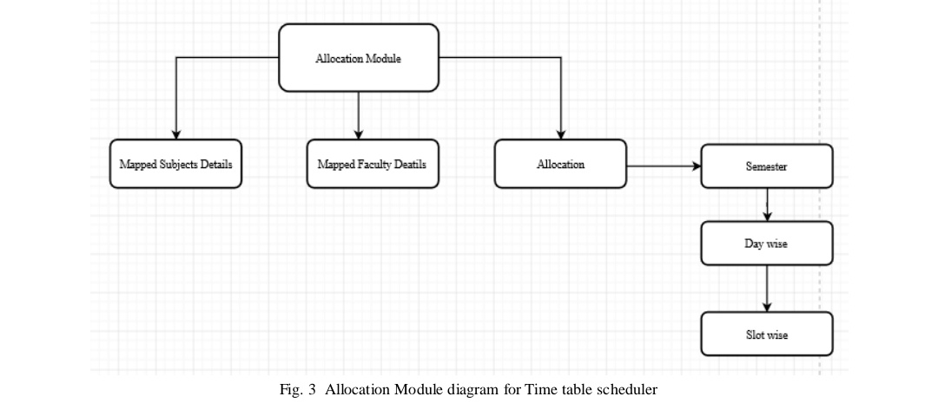
2.6.3 -Admin Module
The admin is responsible for taking all the details of the faculty, course, subject, semester and how many hours a day the classes last. The admin generates the timetable according to all these factors.
Notes:
1. Admin Module
The admin is responsible for taking all the details of the faculty, course, subject, semester and how many hours a day the classes last. The admin generates the timetable according to all these factors

Slide 21
2.6.4- Integration Module
Above all the created department level Timetables will be integrated to form a master Timetable.
Combination of all the department Timetables is Integration module.

Slide 22
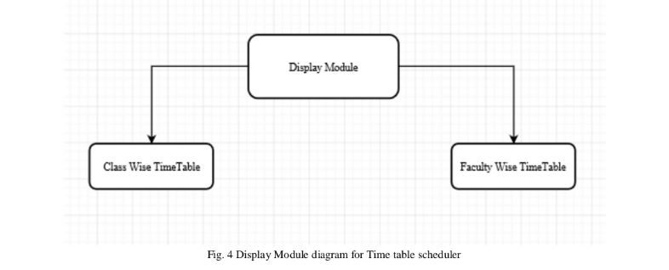
2.6.5 Master Timetable Module
In this module, generation is done by considering the maximum and minimum workload for each faculty. This will be generated by the admin and viewed by the faculty who are the users of this system.

Slide 23
2.7 References
Meysam Shahvali Kohshori, Mohammad saniee abadeh,Hedieh Sajedi “A fuzzy genetic algorithm with local search for university course timetabling” 2008 20th IEEE International conference [1].
Abramson D., Abeh, A Parallel genelic algorithm for Solving the school Timetabling Problem., Royal Melbourne Institute of technology, 1991 [2] .
MlLENA KAROVA Drparliiieiit of Cantpuler Scierice Studenrska I Trcliniral Uiiiversily Vama [3].

Slide 24
3.Planning for next semester

Slide 25
Planning
Next semester we will complete the implementation part.
Firstly we will implement for one particular department.
Then will do for all the departments at once.
Master Time table will be generated without and constraints.

Slide 26
Thank You

